Slide 1

Boolean functions
Individual homework
Bostan Maria Ilinca, group 911

Slide 2
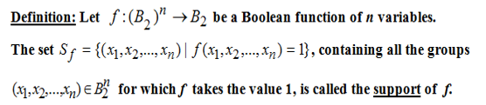
Theoretical Results Quine’s method

Slide 3
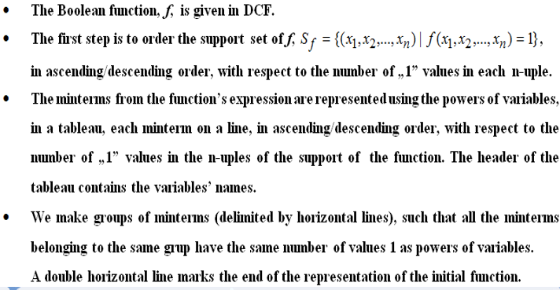

Slide 4
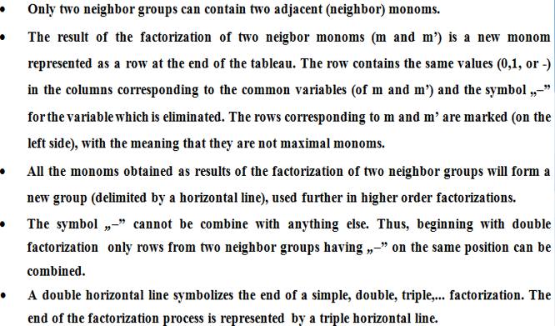

Slide 5
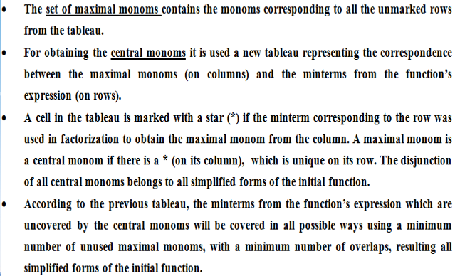

Slide 6

Problem statement 6.1
Using Quine’s method, simplify the following Boolean functions given in DCF (disjunction of minterms):
f1(x1,x2,x3)= m0 ∨ m3 ∨ m4 ∨ m5 ∨ m6 ∨ m7
= x₁⁰ x₂⁰ x₃⁰ ∨ x₁⁰ x₂¹x₃¹ ∨ x₁¹ x₂⁰ x₃⁰ ∨ x₁¹ x₂⁰ x₃¹ ∨ x₁¹ x₂¹ x₃⁰ ∨ x₁¹ x₂¹ x₃¹
= x̅₁ x̅₂ x̅₃ ∨ x̅₁ x₂ x₃ ∨ x₁ x̅₂ x̅₃ ∨ x₁ x̅₂ x₃ ∨ x₁ x₂ x̅̅₃ ∨ x₁ x₂ x₃
S_{f} ={(0,0,0) , (0,1,1) , (1,0,0) , (1,0,1), (1,1,0) , (1,1,1)}
The support of the function f must be sorted in ascending order, with respect to the number of “1” values in each triple. Therefore:
S_{f} ={(0,0,0) , (1,0,0) , (0,1,1) , (1,0,1) , (1,1,0) , (1,1,1)}

Slide 7
GROUP | x1 | x2 | x3
1 ✓ | 0 | 0 | 0 | m0
2 ✓ | 1 | 0 | 0 | m4
3 ✓ ✓ ✓ | 0 1 1 | 1 0 1 | 1 1 0 | m3 m5 m6
4 ✓ | 1 | 1 | 1 | m7
5 = 1+2 | - | 0 | 0 | =m0 m4=max1 = x̅₂ x̅₃
6 = 2 + 3 | 1 1 | 0 - | - ✓ 0 ✓ | = m5 m4 = = x1 x̅₂ = m6 m4 = x1x̅₃
7 = 3 + 4 | - 1 1 | 1 - 1 | 1 1 ✓ - ✓ | = m3 m7=max2 = x2x3 = m5 m7 = x1x3 = m7 m6 =x1x2

Slide 8
Group | X1 | X2 | X3
8 = 6+7 | 1 | - | - | M4 v m5 v m6 v m7 = max 3

Slide 9
M(f) = {max1,max2,max3}
max monoms minterms | max 1 | max2 | max3
m0 | *
m3 |  | *
m4 | * |  | *
m5 |  |  | *
m6 |  |  | *
m7 |  | * | *
The first, second and third rows have a unique (*) . M(f) = C(f)

Slide 10
M(f) = {max1,max2,max3}
C(f) = {max1, max2, max3}
M(f) = C(f)
Solution = max1 v max2 v max3
= ̅x₂ x̅₃ v x2x3 v x1

